Slide 1
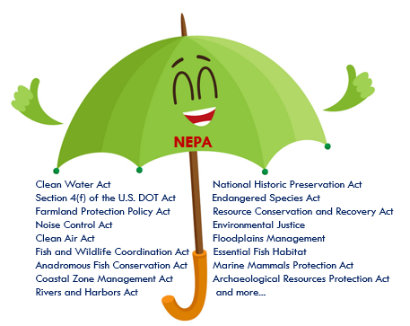
NEPA Assignment
MaineDOT Environmental Office
David Gardner, Director
Kristen Chamberlain, Sr. Environmental Manager
Sierra Millay, Environmental Specialist
Notes:
Hi, my name is Sierra Millay. I am an Environmental Specialist in the Environmental Office at the Maine Department of Transportation. I will guide you through this presentation on NEPA Assignment.

Slide 2
NEPA ASsignment Overview
What is NEPA?
What is NEPA Assignment?
Why is MaineDOT seeking Assignment?
NEPA Assignment Responsibilities
Assignment MOU
Path to NEPA Assignment
Notes:
I will be providing some basic background on NEPA, what NEPA assignment is, why MaineDOT is seeking assignment, the responsibilities that come with assignment, the Memorandum of Understanding, and MaineDOT’s path to assuming FHWA responsibilities for NEPA.

Slide 3
What is NEPA?
The National Environmental Policy Act (NEPA) is a Federal procedural law that establishes a national environmental policy.
NEPA provides a framework for environmental planning and decision-making on projects that receive Federal funds or require Federal approvals.
NEPA requires agencies, when planning projects or issuing permits, to evaluate natural, cultural, social, and economic effects of their actions and provide opportunities for public input.
Notes:
The National Environmental Policy Act or NEPA is a federal procedural law that establishes a national environmental policy. NEPA provides the framework for environmental planning and decision-making., and requires agencies to evaluate the natural, cultural, social, and economic effects of their action while providing opportunities for public input.

Slide 4
NEPA Classes of Action
Categorical Exclusion (CE)
Actions that do not individually or cumulatively have a significant environmental effect are excluded from the requirement to prepare an EA or EIS.
Environmental Assessment (EA)
Actions for which the Administration has not clearly established the significance of the environmental impact.
Environmental Impact Statement (EIS)
Actions that significantly affect the environment require an EIS (40 CFR 1508.27).
Since 2001, MaineDOT has had responsibility for CE determinations via a Programmatic Agreement.
Notes:
There are three classes of action under NEPA. They are:
Categorical Exclusions or CEs. CEs are actions that do not have significant environmental effects and are excluded from the requirement to prepare an EA or EIS. There are a number of actions that fall under a CE. The actions are listed in 23 CFR 771.117 and referred to as the “C” list and “D” list.
Environmental Assessments or EAs. An EA is an action that has not clearly established the significance of the environmental impact.
Environmental Impact Statements or EISs. An EIS is an action that has a significant effect on the environment.

Slide 5
What is NEPA Assignment?
FHWA’s environmental review responsibilities under NEPA are formally transferred to the State DOT.
All NEPA classes of action: CE’s, EA’s and EIS’s (23 U.S. Code. 327) MaineDOT
or just CE’s (23 U.S. Code 326).
Complete or partial transfer of FHWA’s environmental review responsibilities (environmental laws, rules, and orders)
The State, under this program, is deemed Lead Federal Agency for environmental review and consulting with agencies for Federal-aid highway projects
No change to any existing environmental laws. Legal requirements remain the same
Notes:
NEPA Assignment allows State’s to assume Federal Highway Administration’s NEPA responsibilities. MaineDOT will be assuming NEPA responsibilities for CEs, EAs, and EISs under 23 US Code 327. US Code 326 allows states to just assume CE responsibilities.
MaineDOT will also assume responsibility for environmental laws, regulations, and Executive Orders. This includes laws like the Endangered Species Act, Section 106 of the National Historic Preservation Act, the U.S. DOT Act, or Section 4(f).
MaineDOT will act as FHWA for environmental review and consulting with agencies for federal-aid highway projects. This does not change environmental laws. The legal requirements remain the same.

Slide 6
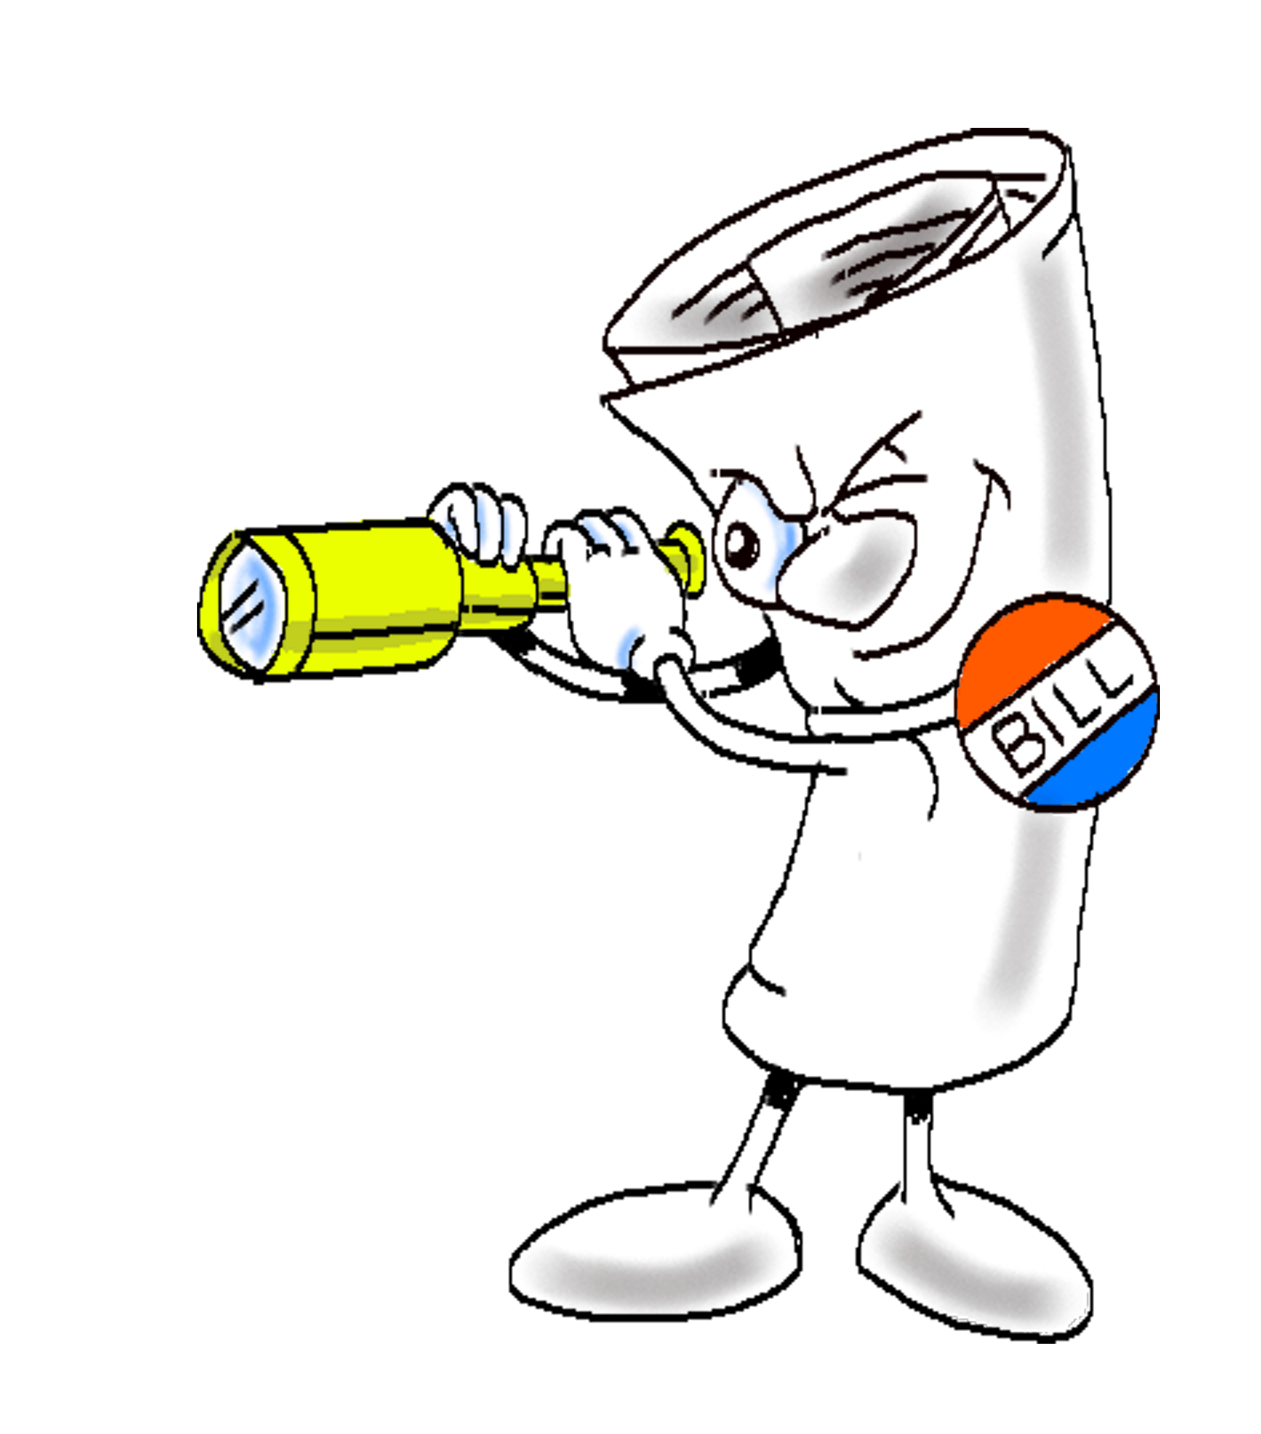
Assignment Background
Transportation Bills
SAFETEA-LU (Safe, Accountable, Flexible, Efficient, Transportation Equity Act) signed into law in 2005
Section 6003 - Pilot program for full NEPA responsibility (Alaska, California, Ohio, Oklahoma, Texas)
Section 6004 - allowed States to assume responsibility for CEs (Alaska, Texas, Utah and California)
MAP-21 (Moving ahead for Progress in the 21st Century Act) 2012
Section 1313 : Pilot program made permanent (NEPA Assignment Program)
Section 6005(a) of the SAFETEA-LU (and updated by MAP-21) established a Surface Transportation Project Delivery Program that allows the Secretary of the U.S. DOT to assign, and a State to assume, the USDOT Secretary's responsibilities under the National Environmental Policy Act of 1969 (42 U.S.C. 4321, et seq.) and all or part of the USDOT Secretary's responsibilities for environmental review, consultation, or other action required under any Federal environmental law.
Notes:
SAFETEA LU established a pilot program for full NEPA assignment in 2005 and also allowed states to assume responsibility for NEPA Categorical Exclusions.
MAP-21 made the pilot program permanent
The Secretary of the U.S. DOT can assign, and a State can assume, the USDOT Secretary's responsibilities under the National Environmental Policy Act of 1969 and all or part of the USDOT Secretary's responsibilities for environmental review, consultation, or other action required under any Federal environmental law.

Slide 7
U.S. Code
CE Assignment - State Assumption of Responsibility for Categorical Exclusions [23 U.S. Code § 326].
Allows State DOTs to accept assignment via Memorandum of Understanding (MOU) to make determinations regarding mostly minor projects whose environmental review is limited to making categorical exclusion (CEs)(23 CFR 771.117) determinations.
NEPA Assignment - Surface Transportation Project Delivery Program (all NEPA - CE/EA/EIS) [23 U.S. Code § 327].
Allows State DOTs to assume FHWA’s NEPA responsibilities by preparing an application and then executing an MOU for a full program of environmental determinations, including Categorical Exclusion (CE), Environmental Assessments (EAs) and Environmental Impact Statements (EISs).
MaineDOT is applying for the Surface Transportation Project Delivery Program to assume all NEPA classes of action from FHWA and all environmental laws, regulations, EO under the NEPA umbrella.
Notes:
Once again, MaineDOT is applying for the Surface Transportation Project Delivery Program to assume all NEPA classes of action from FHWA and all environmental laws, regulations, and Executive Orders under the NEPA umbrella.

Slide 8
Legal requirements
The State must ensure it meets the three main legal requirements in order to enter into CE or NEPA Assignment:
Consent to accept the jurisdiction of the Federal courts - Limited waiver of sovereign immunity.
Language in 23 M.R.S. §4206 (P) satisfies this requirement.
Authority to enter into a Memorandum of Understanding (MOU) for the 326 and/or 327 programs
Language in 23 M.R.S. §4206 (P) satisfies this requirement.
Certify that Freedom of Information Act (FOIA) equivalents are in place
Maine Freedom of Access Act (M.R.S. Title 1 §400 to 521)
Notes:
MaineDOT must ensure it meets three main legal requirements in order to enter into the NEPA Assignment Program.
MaineDOT must consent to accept the jurisdiction of the Federal courts.
Governor Mills approved LD 128 on May 25, 2021. 23 M.R.S. §4206 (P) satisfies this requirement.
2. Authority to enter into a Memorandum of Understanding (MOU) for the 326 and/or 327 programs
23 M.R.S. §4206 (P) also satisfies this requirement.
3. Certify that Freedom of Information Act (FOIA) equivalents are in place
Maine Freedom of Access Act (M.R.S. Title 1 §400 to 521) satifies this requirement.

Slide 9
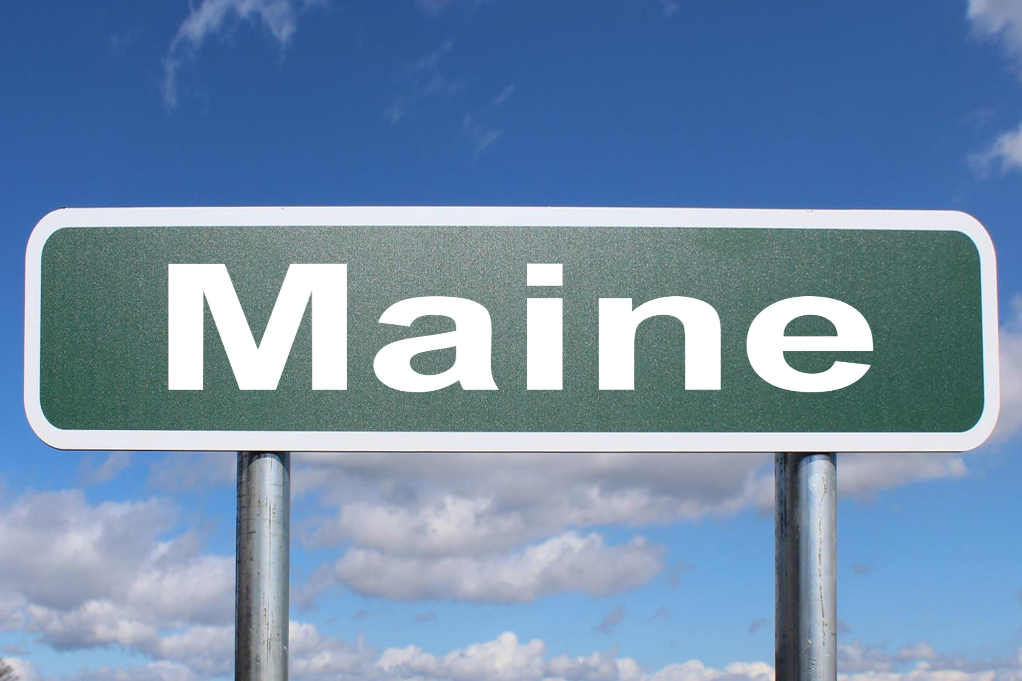
Why is MaineDOT seeking Assignment?
Deliver safety and highway improvement projects faster while preserving environmental quality
Increases efficiency in meeting MaineDOT’s capstone performance measures for work delivered on time and on budget.
Multiple “decision-makers” can be inefficient.
Provides time and cost savings by eliminating a layer of review
Provides for direct consultation between MaineDOT and Others
Streamlining of numerous project decisions
Notes:
Why is MaineDOT Seeking Assignment?
Assignment will allow MaineDOT to deliver safety and highway improvements faster while still preserving environmental quality. Assignment increases efficiency in meeting MaineDOT’s Capstone performance measure of advertising at least 80% of scheduled projects on time.
MaineDOT will be the decision maker, not FHWA.
MaineDOT will consult directly with federal resource and regulatory agencies.
NEPA Assignment will streamline the process. A layer of review will be removed from the project development process. FHWA will not participate in any project decisions or reviews.

Slide 10
Other States and NEPA Assignment
State | Authority | Year
Alaska | 327 | 2017
California | 326/327 | 2007/2007
Texas | 327 | 2014
Ohio | 327 | 2015
Florida | 327 | 2016
Utah | 326/327 | 2008/2017
Nebraska | 326 | 2018
Arizona | 326/327 | 2021/2019
Maine | 327 | TBD
AK
ME
NE
OH
CA
UT
AZ
23 U.S.C. 327 Surface Transportation Delivery Program (Full NEPA Program Assignment)
TX
23 U.S.C. 326 Categorical Exclusion Assignment (CE Assignment)
FL
Both Authorities
NEPA Assignment MOU in Progress
Notes:
There are eight states that currently have NEPA Assignment. Maine will be the ninth. Maine is applying for full assumption under 327.
MaineDOT has on-going discussions with these states to learn the process, ask questions, and obtain advice.

Slide 11
Benefits of Assignment
California, Texas, Ohio Report:
Increased ownership of process and decisions
More efficient environmental review process
Time and cost savings by eliminating a layer of review
Provides for more direct, efficient consultation between State and others
Streamline the Environmental Process-while still meeting environmental protection standards.
State DOT is the “decision-maker”
Notes:
Some of the benefits of assignment are:
Increased ownership of process and decisions
More efficient environmental review process
Time and cost savings by eliminating a layer of review
Provides for more direct, efficient consultation between State and others
Streamline the Environmental Process-while still meeting environmental protection standards.
State DOT is the “decision-maker”

Slide 12
Benefits of Assignment
MaineDOT has professional and experienced staff to carry out the required environmental analysis. A training plan for environment staff and MaineDOT will be maintained.
MaineDOT is already performing the reviews today.
MaineDOT/FHWA have one lawsuit under NEPA in the past 10 years (EA). MaineDOT does not expect Assignment will result in a higher degree of challenges.
The risk to MaineDOT in losing a lawsuit is project stoppage, just as it would be with FHWA. In addition, cost to defend a lawsuit is federal reimbursable as a project cost.
Notes:
MaineDOT has professional and experienced staff to carry out the required environmental analysis. A training plan for environment staff and MaineDOT will be maintained.
MaineDOT is already performing the reviews today.
MaineDOT/FHWA has had one lawsuit under NEPA in the past 10 years (EA). MaineDOT does not expect Assignments will result in a higher degree of challenges.
The risk to MaineDOT in losing a lawsuit is project stoppage, just as it would be with FHWA. In addition, the cost to defend a lawsuit is federally reimbursable as a project cost.

Slide 13
NEPA ASsignment Responsibilities
MaineDOT will assume
Section 7 of the Endangered Species Act Consultation (direct consultation with USFWS and NOAA)
Section 106 of the National Historic Preservation Act Consultation
Section 4(f) of the U.S. DOT Act determinations (Parks, recreation lands, wildlife refuges and historic sites)
Section 404 of the Clean Water Act
All other environmental regulations, Executive Orders, etc. covered under the NEPA Umbrella
MaineDOT acts as the lead agency for environmental review
MaineDOT can not ask FHWA for project-specific assistance with NEPA
MaineDOT leads interagency coordination without FHWA
MaineDOT is the decision-maker
MaineDOT will be legally responsible and liable for all NEPA decisions. (This is not a universal waiver of all the state’s immunity, it is limited to transportation projects in the NEPA Assignment program)
Notes:
MaineDOT will assume
Section 7 of the Endangered Species Act Consultation (direct consultation with USFWS and NOAA)
Section 106 of the National Historic Preservation Act Consultation
Section 4(f) of the U.S. DOT Act determinations (Parks, recreation lands, wildlife refuges and historic sites)
Section 404 of the Clean Water Act
And all other environmental regulations and Executive Orders covered under the NEPA Umbrella
MaineDOT acts as the lead agency for environmental review
MaineDOT can not ask FHWA for project-specific assistance with NEPA
MaineDOT leads interagency coordination without FHWA
MaineDOT is the decision-maker
MaineDOT will be legally responsible and liable for all NEPA decisions. (This is not a universal waiver of all the state’s immunity, it is limited to transportation projects in the NEPA Assignment program)

Slide 14
NEPA Assignment Responsibilities
MaineDOT must:
Maintain appropriate technical and managerial expertise
Maintain adequate financial and staff resources
Demonstrate the capacity to perform the responsibilities
Document all decisions and maintain records
Ensure actions are tracked and accounted for
Train MaineDOT staff in all Bureaus
Report CE determinations and NEPA decisions to FHWA
Perform QA/QC and self-assessments
Coordinate with FHWA monitoring and audits
Notes:
MaineDOT must:
Maintain appropriate technical and managerial expertise
Maintain adequate financial and staff resources
Demonstrate the capacity to perform the responsibilities
Document all decisions and maintain records
Ensure actions are tracked and accounted for
Train MaineDOT staff in all Bureaus
Report CE determinations and NEPA decisions to FHWA
Perform QA/QC and self-assessments
Coordinate with FHWA monitoring and audits

Slide 15
NEPA Assignment Responsibilities
FHWA retains:
Project level air quality conformity determinations (unlisted CE/EA/EIS).
Government-to-Government Tribal consultation
USDOT responsibilities for statewide and metropolitan planning (23 CFR 450)
Projects that cross international or State lines
Projects excluded from Assignment in the MOU
Program Technical assistance and policy interpretation
Auditing and monitoring role for Assignment Program
An annual audit for the first 4 years
Process and Program reviews
Notes:
FHWA retains:
Project level air quality conformity determinations (unlisted CE/EA/EIS).
Government-to-Government Tribal consultation
USDOT responsibilities for statewide and metropolitan planning (23 CFR 450)
Projects that cross international or State lines
Projects excluded from Assignment in the MOU
Program Technical assistance and policy interpretation
Auditing and monitoring role for Assignment Program
An annual audit for the first 4 years
Process and Program reviews

Slide 16
Assignment MOU
The MOU defines the range of project actions and environmental responsibilities the State assumes
MaineDOT must comply with its MOU commitments in assuming FHWA’s environmental responsibilities.
Notes:
FHWA and MaineDOT will execute a Memorandum of Understanding that officially approves MaineDOT's application to participate in the NEPA Assignment Program and to assume the responsibilities of the US DOT Secretary for federal environmental laws with respect to highway projects.
The MOU will define the range of project actions and environmental responsibility.
MaineDOT must comply with the MOU commitments.

Slide 17
Resource Agencies
Resource agencies may not see much change
MaineDOT already handles the program on a day-to-day basis
MaineDOT will solely become responsible and legally liable for decisions.
Processes and Agreements will be changed or addressed to reflect that MaineDOT has assumed FHWA’s responsibilities.
All requirements will be addressed just as they are today.
Notes:
The Resource Agency may not see much change. The MaineDOT Environmental Office already handles much of the program on a day-to-day basis. For example, the MaineDOT Historic Coordinator already conducts most of the Section 106 Process and coordination with the SHPO via a programmatic agreement.
MaineDOT will be solely legally responsible for its NEPA decisions.
MaineDOT will review and address any required changes to existing Programmatic Agreements.
All NEPA-related requirements will be addressed just as they are today.

Slide 18
Path to Assignment
Statement of Interest (submitted to FHWA on 09/14/2020)
Limited waiver of sovereign immunity (23 M.R.S. 4206 (P) enacted 10/18/2021)
Prepare the Application, and make it available to the public (under 327)
Draft Assignment MOU, make available to the public
Update/Address existing Programmatic Agreements and processes
Develop auditing tools
Train and implement
Notes:
MaineDOT has filed a statement of Interest with FHWA. This was completed on September 14th, 2020.
Maine has addressed the limited waiver of sovereign immunity specific to NEPA by enacting 23 MRS 4206 (p).
MaineDOT is currently working on FHWA-identified gaps and finalizing the application.
Once the application is submitted and approved. FHWA and MAineDOT will draft and execute an MOU.
MaineDOT will update programmatic agreements, develop auditing and self-assessment tools, and implement a NEPA assignment training program.

Slide 19
AASHTO Center For Environmental Excellence
State DOTs Streamlining Project Delivery and Protecting the Environment (click here to play)
Notes:
Here is a short video by the Center for Excellence on NEPA Assignment.

Slide 20
MaineDOT Contacts
David Gardner, Environmental Office Director
david.gardner@maine.gov
Kristen Chamberlain, Senior Environmental Manager
kristen.chamberlain@maine.gov
Sierra Millay, Environmental Specialist
sierra.f.millay@maine.gov
Notes:
For further questions, please contact
David Gardner, Environmental Office Director
Kristen Chamberlain, Senior Environmental Manager
Sierra Millay, Environmental Specialist
sierra.f.millay@maine.gov
Thank you.

